Slide 1
Microsoft Azure Security – Open Hack
Subtitle or speaker name

Slide 2


Module 04: Security Operations
Azure Monitor
Azure Security Center
Azure Sentinel
Module Labs

Slide 3
Azure Monitor

Slide 4






Azure Monitor
Azure Monitor
Metrics and Logs
Log Analytics
Connected Sources
Azure Monitor Alerts
Diagnostic Logging
Notes:
Manage security operations (25-30%)
Monitor security by using Azure Monitor
Create and customize alerts
Monitor security logs by using Azure Monitor
Configure diagnostic logging and log retention

Slide 5
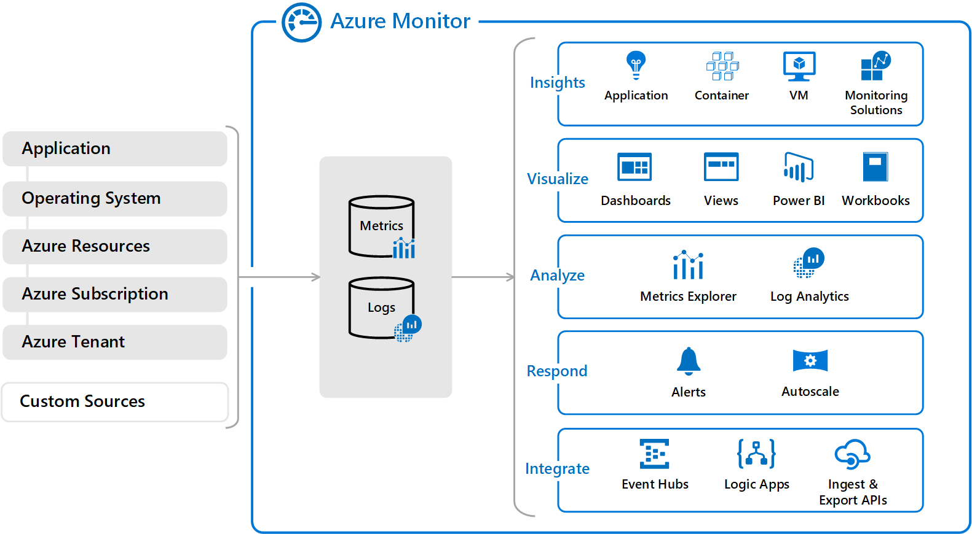
Azure Monitor Architecture
Azure Monitor offers a consolidated pipeline for routing any of your monitoring data into a SIEM tool – Security Center
Notes:
Integrate security solutions in Azure Security Center - https://docs.microsoft.com/en-us/azure/security-center/security-center-partner-integration#exporting-data-to-a-siem
Log Analytics and Alerts are covered in separate slides. SIEM is Security Information and Event Management.
On the left side of the figure are the sources of monitoring data that populate these data stores. On the right side are the different functions that Azure Monitor performs with this collected data, such as analysis, alerting, and streaming to external systems.
All data that Azure Monitor collects fits into one of two fundamental types: metrics or logs. Metrics are numerical values that describe aspects of a system at a point in time. They are lightweight and capable of supporting near-real-time scenarios. Logs contain different kinds of data organized into records with different sets of properties for each type. Logs store telemetry, such as events and traces, and performance data so that it can all be combined for analysis.
For many Azure resources, you’ll find the data that Azure Monitor collects right in the resource’s Overview page in the Azure portal. Check out any virtual machine (VM). for example, and you'll notice several charts displaying performance metrics. Select any of the graphs to open the data in Metrics Explorer, which allows you to chart the values of multiple metrics over time. You can view the charts interactively or pin them to a dashboard to view them with other visualizations.

Slide 6
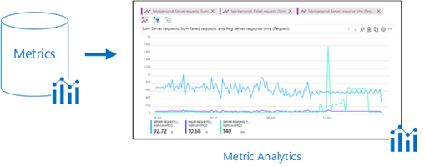
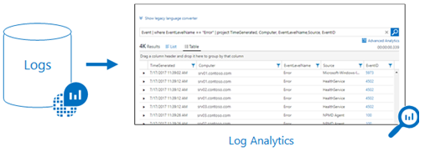
Metrics and Logs
Metrics are numerical values that describe some aspect of a system at a point in time
They are lightweight and capable of supporting near real-time scenarios
Logs contain different kinds of data organized into records with different sets of properties for each type
Telemetry (events, traces) and performance data can be combined for analysis
Notes:
Metrics - https://docs.microsoft.com/en-us/azure/azure-monitor/platform/data-platform-metrics
Logs - https://docs.microsoft.com/en-us/azure/azure-monitor/platform/data-platform-logs

Slide 7
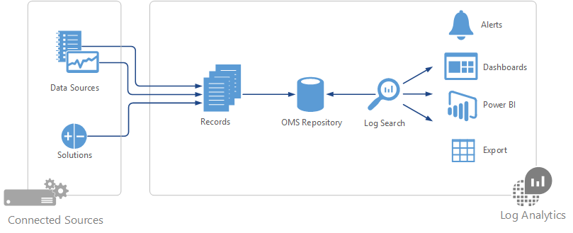
Log Analytics
Collect and analyze resource data (cloud and on-premises) - write log queries and interactively analyze their results.
Notes:
Create a Log Analytics workspace in the Azure portal - https://docs.microsoft.com/en-us/azure/azure-monitor/learn/quick-create-workspace
Azure Log Analytics is a service that helps you collect and analyze data that's generated by resources in your cloud and on-premises environments. It gives you real-time insights by using integrated search and custom dashboards to readily analyze millions of records across all your workloads and servers regardless of their physical locations.
At the center of Log Analytics is the Log Analytics workspace, which is hosted in Azure. Log Analytics collects data in the workspace from connected sources by configuring data sources and adding solutions to your subscription. Data sources and solutions each create different record types, each with its own set of properties. But you can still analyze sources and solutions together in queries to the workspace. This capability allows you to use the same tools and methods to work with a variety of data collected by a variety of sources.
The connected sources are the computers and other resources that generate the data that Log Analytics collects. The sources can include agents installed on Windows and Linux computers that directly connect or agents that exist in a connected System Center Operations Manager management group. Log Analytics can also collect data from an Azure storage account.
The data sources consist of the various kinds of data collected from each connected source. These sources include events and performance data from Windows and Linux agents in addition to sources such as Microsoft Internet Information Services (IIS) logs and custom text logs. You configure each data source that you want to collect, and the configuration is automatically delivered to each connected source.
Four ways exist to collect logs and metrics for Azure services:
• From Azure Diagnostics directly to Log Analytics
• From Azure Diagnostics to Azure storage to Log Analytics
• Via connectors for Azure services
• Via scripts to collect and then post data into Log Analytics

Slide 8
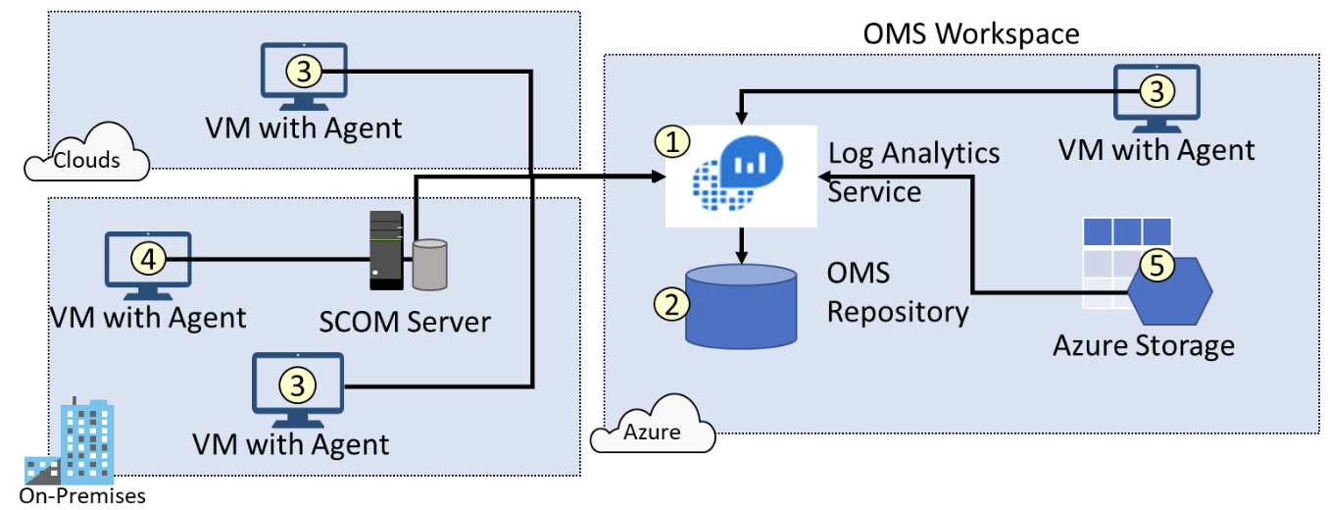
Connected Sources
Connected Sources generate data
Data can be collected from Windows, Linux, SCOM and Azure Storage
Notes:
Log Analytics agent overview - https://docs.microsoft.com/en-us/azure/azure-monitor/platform/log-analytics-agent
Use this slide to explain how data is collected from multiple sources including Azure Services, On premises machines reporting to SCOM and directly to an Log Analytics workspace. Also point out that we can collect data from VM's in other cloud providers. This also ties into Security Center to provide a security posture for on-premises Virtual machines.
Ensure you can locate each of the following.
The Log Analytics service (1) collects data and stores it in the repository (2). The repository is hosted in Azure. Connected Sources provide information to the Log Analytics service.
Computer agents (3) generate data to the Log Analytics service. These agents can run on Windows or Linux computers, virtual or physical computers, on-premises or cloud computers, and Azure or other cloud providers.
A System Center Operations Manager (SCOM) management group can be connected to Log Analytics. SCOM agents (4) communicate with management servers which forward events and performance data to Log Analytics.
An Azure storage account (5) can also collect Azure Diagnostics data from a worker role, web role, or virtual machine in Azure. This information can be sent to the Log Analytics service.

Slide 9
Azure Monitor Alerts
Select the target resource to monitor
Add a condition to select a signal and define the logic
Notify the team or automate follow-on actions
Display by severity (0 to 4)
Administer with New, Acknowledged, and Closed status
Notes:
Overview of alerts in Microsoft Azure - https://docs.microsoft.com/en-us/azure/azure-monitor/platform/alerts-overview

Slide 10
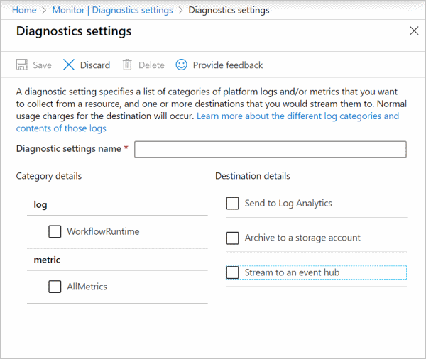
Diagnostic Logging
Resource level logging (NSG rule counters and Key Vault audits)
Different from Activity Logs (operational)
Different from Guest OS Logs (VM agents)
Retention times are available for archiving to a storage account
Notes:
Create diagnostic setting to collect resource logs and metrics in Azure – https://docs.microsoft.com/en-us/azure/azure-monitor/platform/diagnostic-settings
Azure Monitor diagnostic logs are logs produced by an Azure service that provide rich, frequently collected data about the operation of that service. Azure Monitor makes two types of diagnostic logs available:
Tenant logs. These logs come from tenant-level services that exist outside an Azure subscription, such as Azure Active Directory (Azure AD).
Resource logs. These logs come from Azure services that deploy resources within an Azure subscription, such as Network Security Groups (NSGs) or storage accounts.
The content of these logs varies by Azure service and resource type. For example, NSG rule counters and Azure Key Vault audits are two types of diagnostic logs.
These logs differ from the activity log. The activity log provides insight into the operations, such as creating a VM or deleting a logic app, that Azure Resource Manager performed on resources in your subscription using. The activity log is a subscription-level log. Resource-level diagnostic logs provide insight into operations that were performed within that resource itself, such as getting a secret from a key vault.
These logs also differ from guest operating system) (OS–level diagnostic logs. Guest OS diagnostic logs are those collected by an agent running inside a VM or other supported resource type. Resource-level diagnostic logs require no agent and capture resource-specific data from the Azure platform itself, whereas guest OS–level diagnostic logs capture data from the OS and applications running on a VM.

Slide 11
Demonstration: Azure Monitor
Activity logs and alerts
Log analytics
Notes:
In the virtual classroom consider having the students join you in doing the demonstrations. Or you could have someone share their screen and be coached through the demonstration. Consider which demonstrations to provide given your student’s interests and the labs they will be assigned.

Slide 12
Additional Study – Azure Monitor
Module Review Questions
Microsoft Learn Modules (docs.microsoft.com/Learn)
Analyze your Azure infrastructure by using Azure Monitor logs (Exercise)
Design a holistic monitoring strategy on Azure
Monitor and report on security events in Azure AD (Exercise)
Improve incident response with alerting on Azure (Exercise)
Notes:
For students who may be new to Azure or are struggling with the labs consider having them use their lab time going through the Learn modules instead.
(docs.microsoft.com/Learn)
Analyze your Azure infrastructure by using Azure Monitor logs - https://docs.microsoft.com/en-us/learn/modules/analyze-infrastructure-with-azure-monitor-logs/
Manage security operations in Azure - https://docs.microsoft.com/en-us/learn/paths/manage-security-operations/
Design a holistic monitoring strategy on Azure - https://docs.microsoft.com/en-us/learn/modules/design-monitoring-strategy-on-azure/
Monitor and report on security events in Azure AD - https://docs.microsoft.com/en-us/learn/modules/monitor-report-aad-security-events/

Slide 13
Azure Security Center

Slide 14

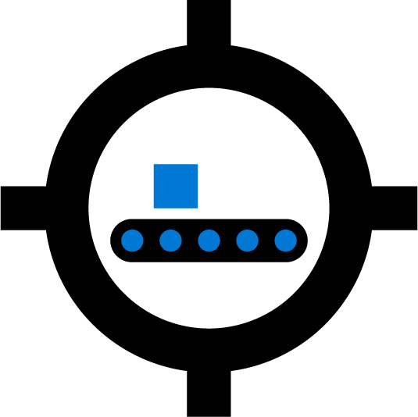
Azure Security Center
Cyber Kill Chain
Azure Security Center Features
Security Center Policies
Security Center Recommendations
Secure Score
Brute Force Attacks
Just in Time Virtual Machine Access
Notes:
Manage security operations (25-30%)
Monitor security by using Azure Security Center
Evaluate vulnerability scans from Azure Security Center
Configure Just in Time VM access by using Azure Security Center
Configure centralized policy management by using Azure Security Center
Configure compliance policies and evaluate for compliance by using Azure Security Center

Slide 15
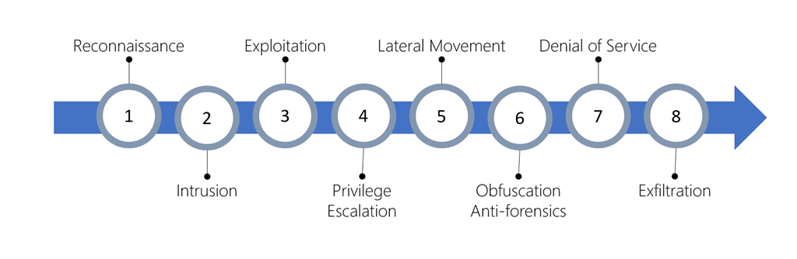
Cyber Kill Chain
Series of steps that trace the stages of a cyberattack
Different types of attacks are associated with each stage, and they target various subsystems
Security Center is designed around the kill chain
Notes:
Intentions - https://docs.microsoft.com/en-us/azure/security-center/alerts-reference#intentions
Reconnaissance: The observation stage where attackers assess your network and services to identify possible targets and techniques to gain entry.
Intrusion: Attackers use knowledge gained in the reconnaissance phase to get access to a part of your network. This often involves exploring a flaw or security hole.
Exploitation: This phase involves exploiting vulnerabilities and inserting malicious code onto the system to get more access.
Privilege Escalation: Attackers often try to gain administrative access to compromised systems so they can get access to more critical data and move into other connected systems.
Lateral Movement: This is the act of moving laterally to connected servers and gain greater access to potential data.
Obfuscation / Anti-forensics: To successfully pull off a cyberattack, attackers need to cover their entry. They will often compromise data and clear audit logs to try to prevent detection by any security team.
Denial of Service: This phase involves disruption of normal access for users and systems to keep the attack from being monitored, tracked, or blocked.
Exfiltration: The final extraction stage: getting valuable data out of the compromised systems.

Slide 16
Azure Security Center Features
Central hub for monitoring security status
Prevent
Detect
Respond
Protects Azure, hybrid, and multi-cloud environments
Continually assesses your environment
Tailored security policies to ensure compliance
Provides threat prevention recommendations and security alerts
Two tiers – Free and Standard
Notes:
Azure Security Center - https://azure.microsoft.com/en-us/services/security-center/
Azure Security Center provides you with a centralized view of your Azure resources and their active security state. It provides integrated security monitoring and policy management across your Azure subscriptions, helps detect threats that might otherwise go unnoticed, and works with a broad ecosystem of security solutions. These solutions are delivered through the following capabilities:
• Prevention. Security Center monitors the state of your Azure resources based on how you configure the security policies for your organization, applications, and data.
• Detection. Security Center automatically collects and analyzes security data from your Azure resources; the network; and partner solutions, like antimalware and firewalls. It takes advantage of global threat intelligence from Microsoft products and services, the Microsoft Digital Crimes Unit, the Microsoft Security Response Center, and external feeds.
• Response. Security Center provides you with prioritized security and incident alerts. It offers insights into the source of an attack and any impacted resources along with suggestions for how to stop the current attack and help prevent future attacks.

Slide 17
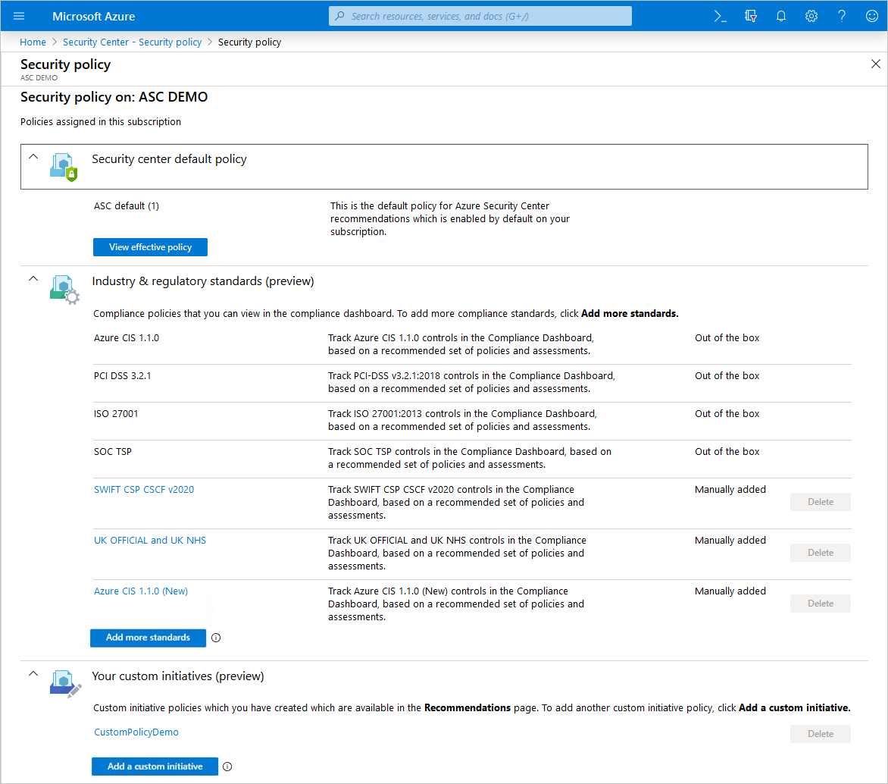
Security Center Policies
Defines the desired configuration for workloads
View and edit the built-in default policy
Add your own custom policies
Add regulatory compliance policies
Ensures compliance and regulatory requirements
Notes:
Working with security policies - https://docs.microsoft.com/en-us/azure/security-center/tutorial-security-policy
Azure security policies monitored by Security Center - https://docs.microsoft.com/en-us/azure/security-center/security-center-policy-definitions

Slide 18
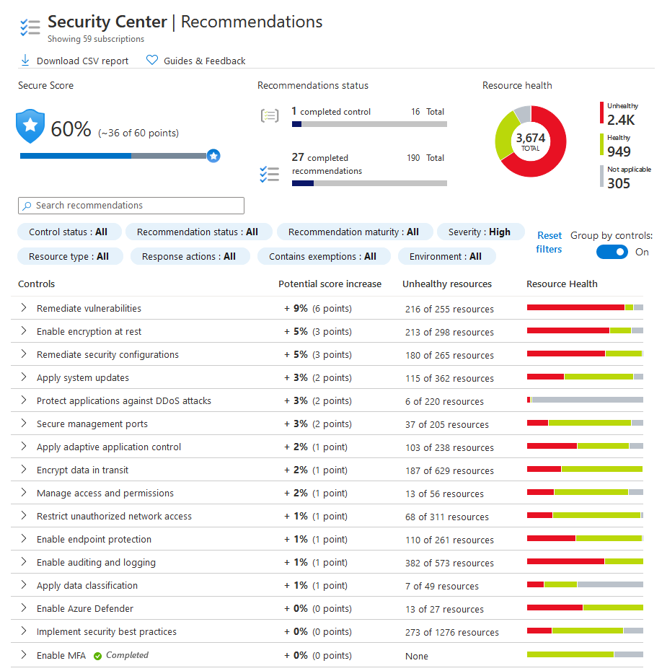
Security Center Recommendations
Enabling a policy enables recommendations for that policy
Recommendations are grouped by Severity
Covers networks, containers, app service, compute and app, virtual machine scale sets, data and storage, identity and access
Remediation improves your Secure Score (next topic)
Notes:
Security Recommendations - Reference Guide - https://docs.microsoft.com/en-us/azure/security-center/recommendations-reference
Take a few minutes to review the different recommendations in the Reference Guide or in the Portal.
By default, all prevention policies are turned on. Prevention policies and recommendations are tied to each other. In other words, if you enable a prevention policy, such as OS vulnerabilities, that enables recommendations for that policy. In most situations, you want to enable all policies even though some might be more important to you than others, depending on the Azure resource you’ve deployed.
The following is a generated list of the types of recommendations. The recommendations help provide full visibility into the security health of your environment.

Slide 19
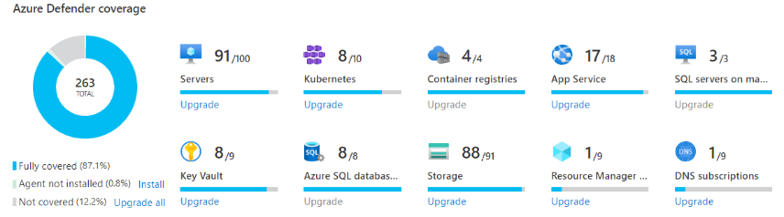
Azure Defender
Cloud workload protection (CWP)
Dashboard shows your Defender coverage
Multiple flavors of Azure Defender: SQL, AKS, Storage, IoT, and more.
Notes:
Source - Overview of Azure Defender and the available plans | Microsoft Docs
Enabling Azure Defender extends the capabilities of Security Center to workloads running in private and other public clouds, providing unified security management and threat protection across your hybrid cloud workloads.
Microsoft Defender for Endpoint - Azure Defender for servers includes Microsoft Defender for Endpoint for comprehensive endpoint detection and response (EDR). Learn more about the benefits of using Microsoft Defender for Endpoint together with Azure Defender in Use Security Center's integrated EDR solution.
Vulnerability scanning for virtual machines and container registries - Easily deploy a scanner to all of your virtual machines that provides the industry's most advanced solution for vulnerability management. View, investigate, and remediate the findings directly within Security Center.
Hybrid security – Get a unified view of security across all of your on-premises and cloud workloads. Apply security policies and continuously assess the security of your hybrid cloud workloads to ensure compliance with security standards. Collect, search, and analyze security data from multiple sources, including firewalls and other partner solutions.
Threat protection alerts - Advanced behavioral analytics and the Microsoft Intelligent Security Graph provide an edge over evolving cyber-attacks. Built-in behavioral analytics and machine learning can identify attacks and zero-day exploits. Monitor networks, machines, and cloud services for incoming attacks and post-breach activity. Streamline investigation with interactive tools and contextual threat intelligence.
Access and application controls (AAC) - Block malware and other unwanted applications by applying machine learning powered recommendations adapted to your specific workloads to create allow and deny lists. Reduce the network attack surface with just-in-time, controlled access to management ports on Azure VMs. AAC drastically reduces exposure to brute force and other network attacks.
Container security features - Benefit from vulnerability management and real-time threat protection on your containerized environments. When enabling the Azure Defender for container registries, it may take up to 12 hrs until all the features are enabled. Charges are based on the number of unique container images pushed to your connected registry. After an image has been scanned once, you won't be charged for it again unless it's modified and pushed once more.
Breadth threat protection for resources connected to the Azure environment - Azure Defender includes Azure-native breadth threat protection for the Azure services common to all of your resources: Azure Resource Manager, Azure DNS, Azure network layer, and Azure Key Vault. Azure Defender has unique visibility into the Azure management layer and the Azure DNS layer, and can therefore protect cloud resources that are connected to those layers.

Slide 20
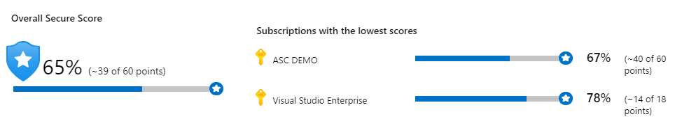
Secure Score
A snapshot of your current security situation
Helps prioritize and manage your security efforts
The higher the score, the lower the identified risk level
Your score only improves if you remediate all the recommendations for a single resource within a control
Notes:
Enhanced secure score (preview) in Azure Security Center - https://docs.microsoft.com/en-us/azure/security-center/secure-score-security-controls
To analyze how well one is protected from various threats, a security score would be very helpful. With so many services offering security benefits, it's often hard to know which what steps to take first to help secure and harden your workload. Azure Secure Score reviews your security recommendations and prioritizes them for you, so you know which recommendations to perform first. This helps you find the most serious security vulnerabilities so you can prioritize your investigation. Azure Secure Score helps you assess your workload security posture.
Azure Security Score calculation
Security Center mimics the work of a security analyst, reviewing your security recommendations and applying advanced algorithms to determine how crucial each recommendation is. Security Center constantly reviews your active recommendations and calculates your secure score based on them. The score of a recommendation is derived from its severity and from security best practices that will affect your workload security the most.
Security Center also provides you with an overall secure score.
The overall secure score is an accumulation of all your recommendation scores. You can view your overall secure score across your subscriptions or management groups, depending on what you select. The score varies based on the selected subscriptions and the active recommendations for those subscriptions.
To check which recommendations, impact your secure score most, you can view the top three most impactful recommendations on the Security Center dashboard, or you can sort the recommendations on the recommendations list blade by using the Secure score impact column.

Slide 21





Brute Force Attacks
Targets management ports to gain access to a virtual machine
Disable the public IP address
Use Point-to-Site VPN, Site-to-Site VPN, Azure ExpressRoute, or Bastion
Require two-factor authentication
Use complex passwords
Limit the time that the ports are open (next slide)
Notes:
Attack Scenario - https://docs.microsoft.com/en-us/azure/security-center/security-center-just-in-time#attack-scenario
When it comes to managing Azure VMs, administrators usually use Remote Desktop (for Windows) or Secure Shell (SSH) (for Linux) to remotely connect to and manage them.
The initial method to get access to these VMs was Remote Desktop Protocol (RDP) brute-force attacks. A brute-force attack consists of checking all possible usernames or passwords until the correct one is found. (This isn’t the most sophisticated form of attack, but it’s relatively simple to perform and, given enough time, it works.)
To blunt RDP brute-force attacks, you can take multiple measures, such as:
Disabling the public IP address and using one of these connection methods:
Point-to-site virtual private network (VPN)
Site-to-site VPN
Azure ExpressRoute
Azure Bastion -- Azure Bastion | Microsoft Docs
Requiring two-factor authentication
Using complex passwords
Limiting the amount of time that the ports are open
Common Attack Types reported by ASC - Reference table for all security alerts in Azure Security Center | Microsoft Docs
MITRE Att&ck Framework --

Slide 22
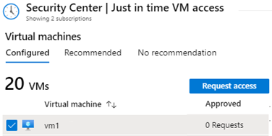
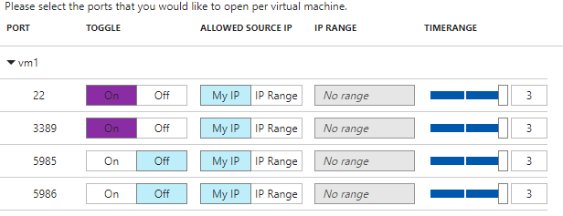
Just in Time Virtual Machine Access
Recommends virtual machines in NSGs with public IP addresses
Select virtual machines and configure ports, source IP addresses, and time range
Security Center locks down inbound traffic by creating an NSG rule
Events are captured in the Activity Log
Notes:
Secure your management ports with just-in-time access - https://docs.microsoft.com/en-us/azure/security-center/security-center-just-in-time
Azure Security Center implements the last method by using just-in-time (JIT) VM Access, which allows you to help secure remote access to one or more VMs. JIT VM Access reduces the exposure time of privileges and increases your visibility into the use of privileged accounts.
When you enable JIT VM Access for your VMs, you can create a policy that determines the ports to help protect, how long ports should remain open, and the approved IP addresses that can access these ports. The policy helps you stay in control of what users can do when they request access. Requests are logged in the Azure activity log, so you can easily monitor and audit access. The policy will also help you quickly identify the existing VMs that have JIT VM Access enabled and the VMs where JIT VM Access is recommended.
Reasons that can cause a VM not to be recommended are:
Missing NSG - The just-in-time solution requires an NSG to be in place.
Classic VM - Security Center just-in-time VM access currently supports only VMs deployed through Azure Resource Manager. A classic deployment is not supported by the just-in-time solution.
Other - A VM is in this category if the just-in-time solution is turned off in the security policy of the subscription or the resource group, or if the VM is missing a public IP and doesn't have an NSG in place.

Slide 23
Demonstration: Azure Security Center
Review Security Center recommendations
Review Security Center policies
Review Security Center regulatory compliance
Notes:
In the virtual classroom consider having the students join you in doing the demonstrations. Or you could have someone share their screen and be coached through the demonstration. Consider which demonstrations to provide given your student’s interests and the labs they will be assigned.

Slide 24
Additional Study – Azure Security Center
Module Review Questions
Microsoft Learn Modules (docs.microsoft.com/Learn)
Resolve security threats with Azure Security Center (Exercise)
Protect your servers and VMs from brute-force and malware attacks with Azure Security Center (Exercise)
Identify security threats with Azure Security Center
Top 5 security items to consider before pushing to production
Notes:
For students who may be new to Azure or are struggling with the labs consider having them use their lab time going through the Learn modules instead.
(docs.microsoft.com/Learn)
Identify security threats with Azure Security Center - https://docs.microsoft.com/en-us/learn/modules/identify-threats-with-azure-security-center/
Resolve security threats with Azure Security Center - https://docs.microsoft.com/en-us/learn/modules/resolve-threats-with-azure-security-center
Protect your servers and VMs from brute-force and malware attacks with Azure Security Center - https://docs.microsoft.com/en-us/learn/modules/secure-vms-with-azure-security-center/
Top 5 security items to consider before pushing to production - https://docs.microsoft.com/en-us/learn/modules/top-5-security-items-to-consider/

Slide 25
Azure Sentinel

Slide 26

Azure Sentinel
Azure Sentinel
Data Connections
Workbooks
Incidents
Playbooks
Hunting
Notes:
Manage security operations (25-30%)
Monitor security by using Azure Sentinel
Create and customize alerts
Configure data sources to Azure Sentinel
Evaluate results from Azure Sentinel
Configure a playbook for a security event by using Azure Sentinel

Slide 27
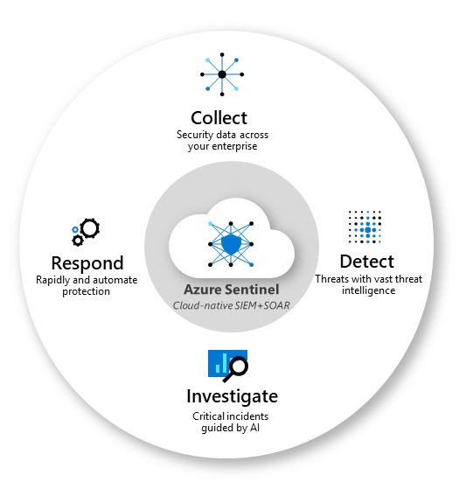
Azure Sentinel
Collect data at cloud scale across all users, devices, applications, and infrastructure
Detect threats, and minimize false positives
Investigate threats with artificial intelligence, and hunt for suspicious activities at scale
Respond to incidents rapidly with built-in orchestration and automation of common tasks
Notes:
Azure Sentinel - https://docs.microsoft.com/en-us/azure/sentinel/overview
Security Information Event Management (SIEM)
Security Orchestration Automated Response (SOAR)

Slide 28
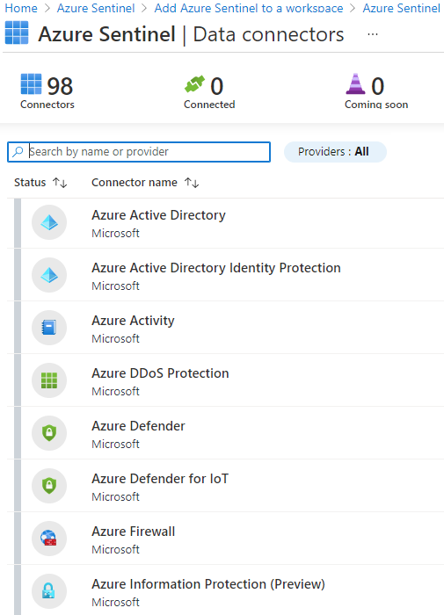
Data Connections
Service to service integration (AWS, Azure AD, Office 365 .. )
External solutions via API (Barracuda, F5 BIG-IP, ForcePoint DLP … )
External solutions that can perform real-time log streaming using the Syslog protocol, via an agent (Cisco ASA, Fortinet … )
Notes:
QuickStart: On-board Azure Sentinel - https://docs.microsoft.com/en-us/azure/sentinel/quickstart-onboard
Connect data sources - https://docs.microsoft.com/en-us/azure/sentinel/connect-data-sources
Instructor Note → The number of connectors is growing on a regular basis. Use this graphic as an example.

Slide 29
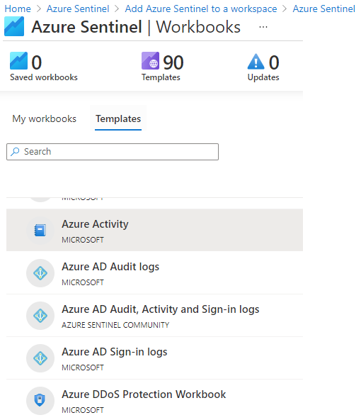
Workbooks
Analyze and correlate all user operations and events
Learn about all user operations, trends, and anomalous changes over time
Drill down into caller activities and summarize detected failure and warning events
Notes:
Workbooks - https://docs.microsoft.com/en-us/azure/sentinel/overview#workbooks
Note to trainer → There are currently 90 templates available, however this number grows often.

Slide 30
Incidents
Create incidents when an alert is triggered from a connected source
Select from built-in rule templates or create your own
Use Azure AD Information Protection to automatically enable incident generation when connected
Notes:
Automatically create incidents from Microsoft security alerts - https://docs.microsoft.com/en-us/azure/sentinel/create-incidents-from-alerts

Slide 31
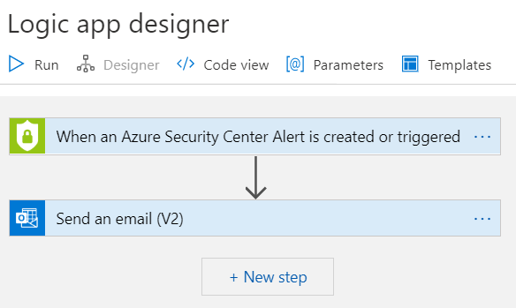
Playbooks
Collection of procedures that can be run from Azure Sentinel in response to an alert
Based on Azure Logic Apps – 200+ connectors
Can be run manually or set to run automatically
Notes:
Security automation & orchestration - https://docs.microsoft.com/en-us/azure/sentinel/overview#security-automation--orchestration
Tutorial: Set up automated threat responses in Azure Sentinel - https://docs.microsoft.com/en-us/azure/sentinel/tutorial-respond-threats-playbook
Automate your common tasks and simplify security orchestration with playbooks that integrate with Azure services as well as your existing tools. Built on the foundation of Azure Logic Apps, Azure Sentinel's automation and orchestration solution provides a highly-extensible architecture that enables scalable automation as new technologies and threats emerge. To build playbooks with Azure Logic Apps, you can choose from a growing gallery of built-in playbooks. These include 200+ connectors for services such as Azure functions. The connectors allow you to apply any custom logic in code, ServiceNow, Jira, Zendesk, HTTP requests, Microsoft Teams, Slack, Windows Defender ATP, and Cloud App Security.
For example, if you use the ServiceNow ticketing system, you can use the tools provided to use Azure Logic Apps to automate your workflows and open a ticket in ServiceNow each time a particular event is detected.

Slide 32
Hunting
Built-in hunting queries
Create a Log Analytics workspace
Custom queries with IntelliSense
Create bookmarks for later review
Jupyter notebooks and Python integration
Notes:
Hunt for threats with Azure Sentinel - https://docs.microsoft.com/en-us/azure/sentinel/hunting
Community GitHub Repository https://aka.ms/asicommunity

Slide 33
Additional Study - Sentinel
Module Review Questions
Microsoft Learn Modules (docs.microsoft.com/Learn)
Introduction to threat modeling
Use a framework to identify threats and find ways to reduce or eliminate risk
Create a threat model using data-flow diagram elements
Notes:
For students who may be new to Azure or are struggling with the labs consider having them use their lab time going through the Learn modules instead.
(docs.microsoft.com/Learn)
Introduction to threat modeling - https://docs.microsoft.com/en-us/learn/modules/tm-introduction-to-threat-modeling/
Use a framework to identify threats and find ways to reduce or eliminate risk - https://docs.microsoft.com/en-us/learn/modules/tm-use-a-framework-to-identify-threats-and-find-ways-to-reduce-or-eliminate-risk/
Create a threat model using data-flow diagram elements - https://docs.microsoft.com/en-us/learn/modules/tm-create-a-threat-model-using-foundational-data-flow-diagram-elements/

Slide 34
Module Labs

Slide 35


Lab 13 – Azure Monitor
Deploy an Azure virtual machine
Event and performance data
Create a Log Analytics workspace
Connected Source
Enable the Log Analytics virtual machine extension
Collect virtual machine event and performance data
Repository
View and query collected data
Log Search
Notes:
Lab scenario
You have been asked to create a proof of concept of monitoring virtual machine performance. Specifically, you want to:
Configure a virtual machine such that telemetry and logs can be collected.
Show what telemetry and logs can be collected.
Show how the data can be used and queried.
Lab exercises
Exercise 1: Collect data from an Azure virtual machine with Azure Monitor

Slide 36




Lab 13 – Azure Monitor
Exercise1, Task1
AZ500LAB131415
myVnet 192.168.0.0/16
mySubnet 192.168.1.0/24
Exercise1, Task2, Task3, Task4, Task5
myVM
192.168.1.4
Log Analytics Workspaces

Slide 37


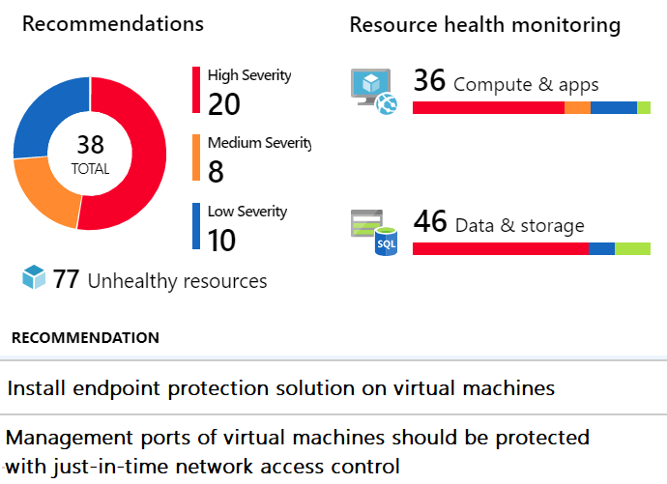
Lab 14 – Azure Security Center
Configure Security Center to monitor a virtual machine
Review Security Center recommendations for the virtual machine
Implement recommendations for endpoint protection and Just in time VM access
Review the Secure Score
Notes:
Lab scenario
You have been asked to create a proof of concept of Security Center-based environment. Specifically, you want to:
Configure Security Center to monitor a virtual machine.
Review Security Center recommendations for the virtual machine.
Implement recommendations for guest configuration and Just in time VM access.
Review how the Secure Score can be used to determine progress toward creating a more secure infrastructure.
Lab exercises
Exercise 1: Implement Security Center

Slide 38

Lab 14 – Azure Security Center
Lab13, Exercise1, Task1
AZ500LAB131415
myVnet 192.168.0.0/16
mySubnet 192.168.1.0/24
Lab13, Exercise1, Task2, Task3, Task4, Task5
myVM
192.168.1.4
Log Analytics Workspaces
Lab14, Exercise1, Task1, Task2, Task3
Azure Security Center

Slide 39


Lab 15 – Azure Sentinel
On-board Azure Sentinel
Connect Azure Activity to Sentinel
Azure Activity
Review and create a rule that uses the Azure Activity data connector
Azure Sentinel
Create a playbook
Rule
JIT management port access removed
Create a custom alert and configure the playbook as an automated response
Invoke an incident and review the associated actions
Playbook
Notes:
Lab scenario
You have been asked to create a proof of concept of Azure Sentinel-based threat detection and response. Specifically, you want to:
Start collecting data from Azure Activity and Security Center.
Add built in and custom alerts
Review how Playbooks can be used to automate a response to an incident.
Lab objectives
In this lab, you will complete the following exercise:
Exercise 1: Implement Azure Sentinel

Slide 40


Lab 15 – Azure Sentinel
Lab13, Exercise1, Task1
AZ500LAB131415
myVnet 192.168.0.0/16
mySubnet 192.168.1.0/24
Lab15, Exercise1, Task4
Lab13, Exercise1, Task2, Task3, Task4, Task5
myVM
192.168.1.4
Log Analytics workspaces
Change-Incident-Severity
Lab15, Exercise1, Task1, Task2, Task3, Task5, Task6
Lab14, Exercise1, Task1, Task2, Task3
Azure Sentinel
Azure Security Center

Slide 41
Microsoft Cloud Workshops (Optional)
Intelligent Cloud Architect Bootcamps
Packaged white board design sessions with step-by-step instructions and solutions
For individuals or small groups
Notes:
These Workshops provide an individual or small group experience that could be used as a Capstone event for the course. There are several workshops that might of interest: Enterprise-ready cloud, Hybrid identity, and Security baseline on Azure.

Slide 42
End of presentation

